Slide 1
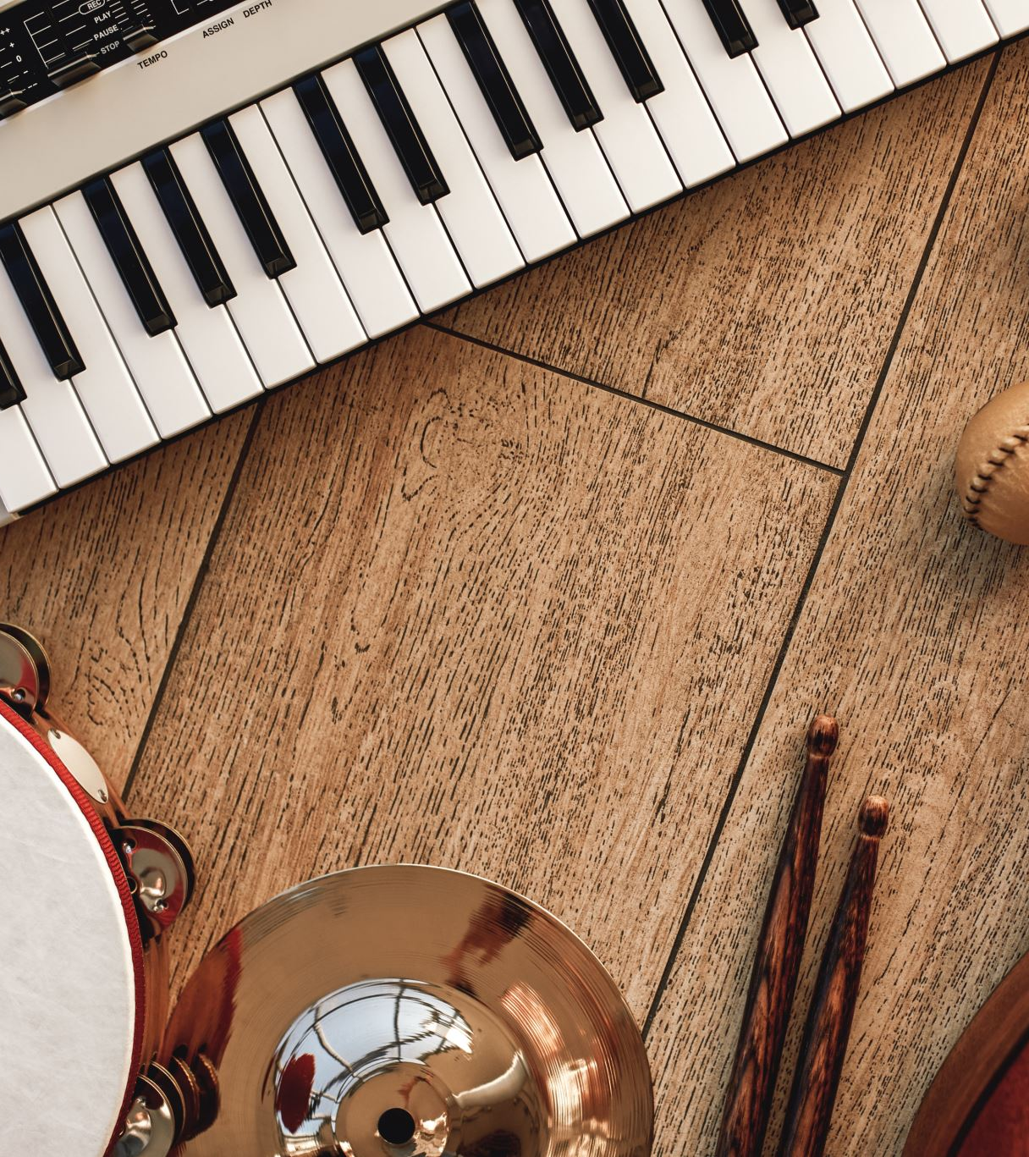
Classical Music Generation
Group-1 Members:
Sairam Venkatachalam
Devarsh Sheth
Disha Kacha
Guided By: Prof. Amir Jafari

Slide 2
Introduction
The Topic
Using Neural Network models to generate classical music
Motivation:
As music enthusiasts, we were interested in exploring the predictability of classical music patterns
We wanted to explore the possibility of generating authentic classical compositions indistinguishable to the human ear.
Data Source:
The dataset consists of classical music compositions in the MIDI format.

Slide 3
Project Flow
Load the Midi Files
Pre-Process and extract Notes and Instruments
Create Musical Sequences
Create Midi Output
Generate Musical Sequences
Build and train the Model

Slide 4
Data Pre-Processing: Note Extraction
Loading Midi Files for a specific Composer
Extracting the instruments and notes detected using pretty midi
Extracting the pitch, velocity, start and end time for each note

Slide 5
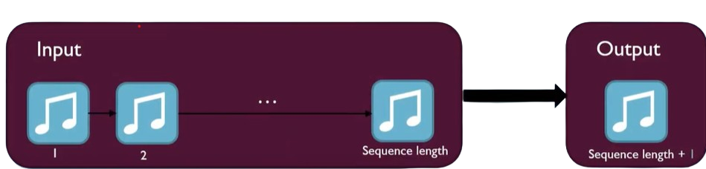
Data Pre-Processing: Sequence Generation
Define a Sequence Length (30)
Create Input Sequences of 30 continuous notes
Create Target Sequence as the 31st note
Convert the Target Sequence to a 1 hot encoded vector

Slide 6
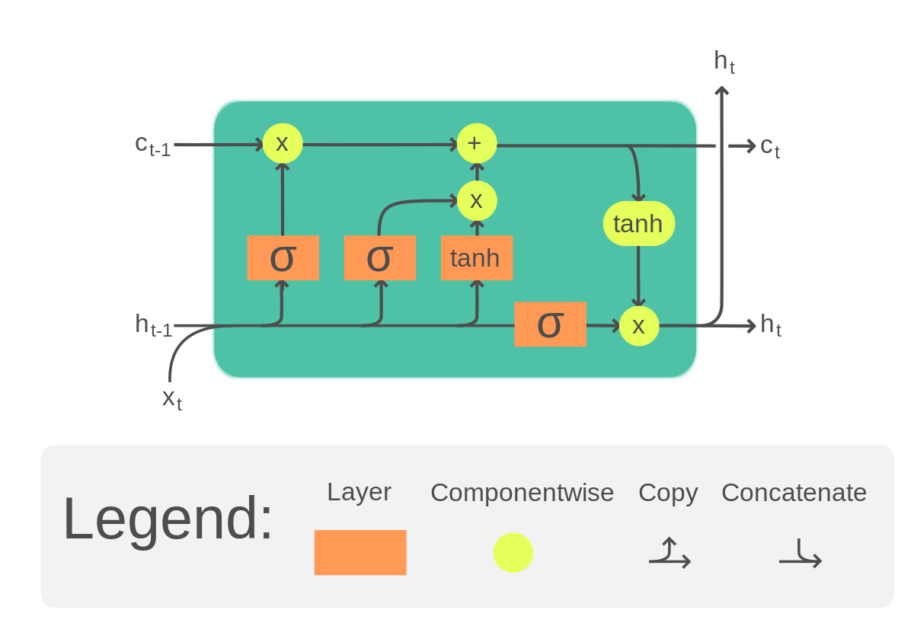
Model Architecture
Input (1 Dim)
Long Short-Term Memory Cell
Embedding Layer (100 Dim)
LSTM Layer
LSTM Layer
Softmax Output (128 Dim)

Slide 7

ResulTs
Actual
Generated

Slide 8
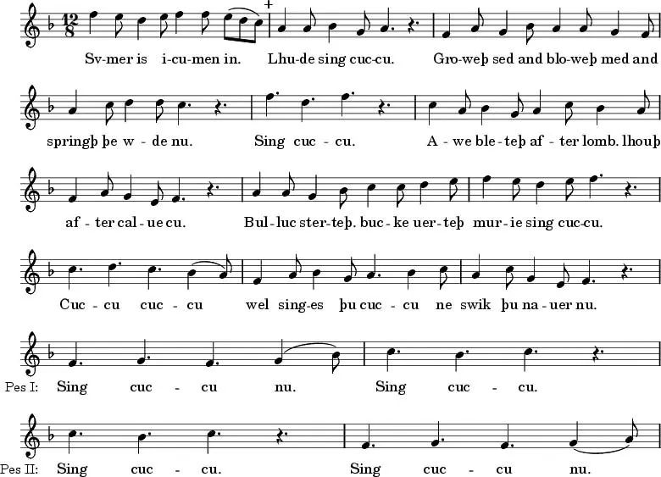
Capturing Tempo Changes
Actual
The next note prediction approach works well, however, it lacks in rhythmic depth.
We attempted to train our model to also capture note durations.

Slide 9
Conclusion and Future Scope
Actual
Explore different architectures: Experiment with different LSTM configurations and additional layers, different models such as VAEs, GANs and many more.
Improve data representation: Use more sophisticated methods to represent musical data, such as encoding musical features.
Incorporate attention mechanisms: Enhance the model's ability to focus on relevant parts of the input sequence.
Generate longer sequences: Extend the model to generate longer musical sequences to capture more complex patterns.

Slide 10
Thank You
Actual

